Slide 1
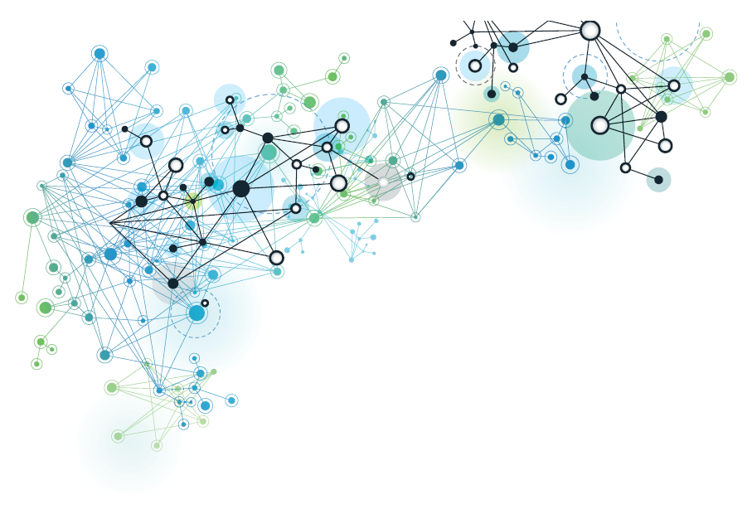




Mobilizing Big Data to control corruption risks in development aid contracts.
Insights for IDB
Mihály Fazekas
Central European University and Government Transparency Institute
misi.fazekas@gmail.com
Inter-American Development Bank, BBL, Washington DC, 29/8/2018

Slide 2
Three main topics
Recent innovations in corruption measurement
  Applicatons to IDB data
Data can be mobilized for development
Currently available or easily acceible data can be used on the short term for monitoring and policy guidance
Widening access and increasing oversight
Understanding corruption displacement effects

Slide 3
I. Corruption proxies & underlying data

Slide 4
Corruption definition
In public procurement, the aim of corruption is to steer the contract to the favored bidder without detection. This is done in a number of ways, including:
  Avoiding competition through, e.g., unjustified sole sourcing or direct contract awards.
  Favoring a certain bidder by tailoring specifications, sharing inside information, etc.
See: World Bank Integrity Presidency (2009) Fraud and Corruption. Awareness Handbook, World Bank, Washington DC. pp. 7.
Notes:
Not necesarily illegal!

Slide 5
Conceptualizing public procurement corruption indicators
Tendering Risk Indicators (TRI)
Contracting body
Supplier
Contract
Particularistic tie
Contracting Body Risk Indicators (CBRI)
Supplier Risk Indicators (SRI)
Political Connections Indicators (PCI)
Source: Fazekas, M., Cingolani, L., & Tóth, B. (2016). A comprehensive review of objective corruption proxies in public procurement: risky actors, transactions, and vehicles of rent extraction: GTI-WP/2016:03. Government Transparency Institute. Budapest.
Notes:
5-20 tested indicators in each group

Slide 6
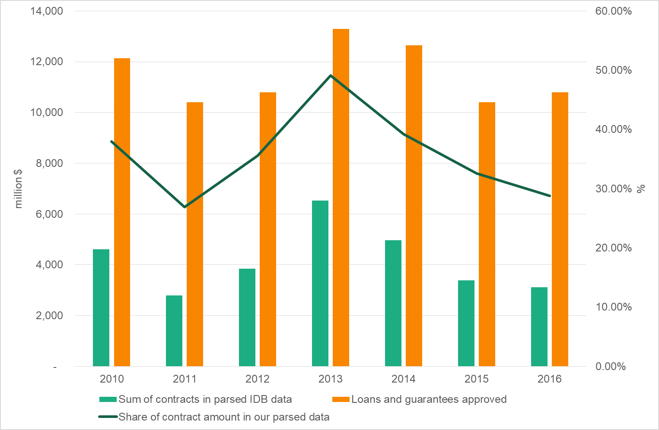
IDB: contracts & projects data
Source (web scraping): http://www.iadb.org/en/projects/project-procurement,8148.html
Scope of IDB contract awards dataset

Slide 7
Corruption risk indicators: IDB
Indicator | Definition | Level | Time span | macro validity | micro validity | shortlist
Non-open procedures | 1=non-open procedure types (DC,OTHER) 0=open procedure types (e.g. internat.comp.bidding) | Tender (goods& works) | 1991-2016 | No | Low
Spending on consultancy | 1=consultancy procured 0=non-consultancy type product purchased | Tender | 1991-2016 | High | Moderate | x
Supplier tax haven registration | 1=Foreign supplier registered in a tax haven 0=Foreign supplier registered in non-tax haven (or Domestic supplier) | Tender | 1991-2016 | High | Moderate | x
Share of published contract awards | sum of contract awards amount / total project cost | Project | 1991-2016 | Moderate | Low - Moderate | x
Agency/supplier capture | spending share of largest supplier/buyer | Tender | 1991-2016 | na | na

Slide 8
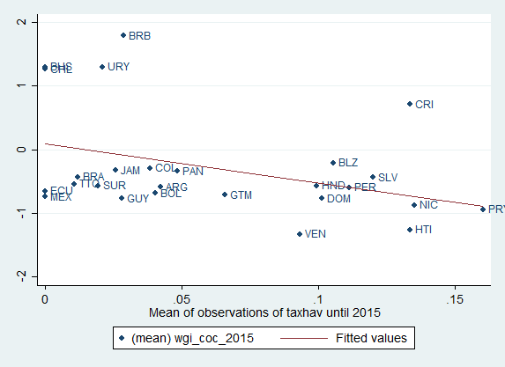
Macro validity
WGI-Control of Corruption vs
supplier tax haven registration (2015, IDB financed contracts)

Slide 9
Agency capture
Distribution of buyers awardig IDB financed contracts according to max spending share of dominant supplier (annual, 10+ contracts)
BUT, need for organisation name cleaning

Slide 10
I. Corruption proxies & underlying data: European examples

Slide 11
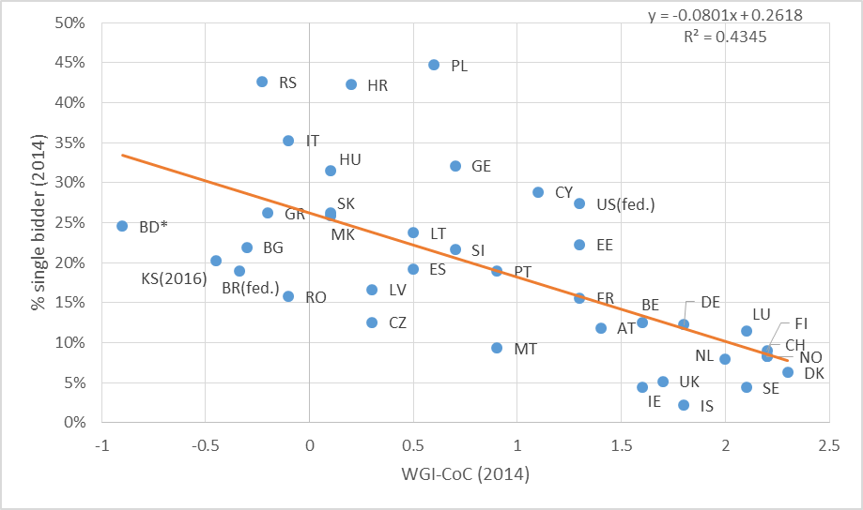
Lack of competition ~ single bidding
(on national competitive markets)
Single bidding correlates with subjective indicators of corruption
Notes:
N=587,075 contracts
Source: Fazekas, M., & Kocsis, G. (2017). Uncovering High-Level Corruption: Cross-National Corruption Proxies Using Government Contracting Data. British Journal of Political Science. https://www.cambridge.org/core/journals/british-journal-of-political-science/article/uncovering-highlevel-corruption-crossnational-objective-corruption-risk-indicators-using-public-procurement-data/8A1742693965AA92BE4D2BA53EADFDF0
and own calculations using national public procurement data for outside the EU-EEA

Slide 12
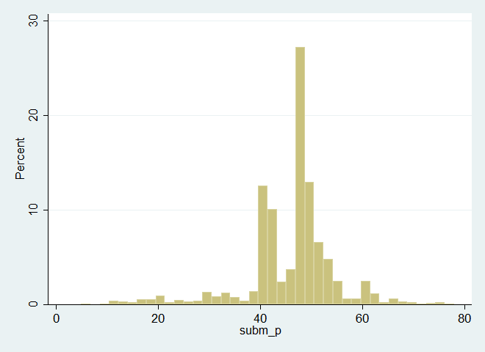
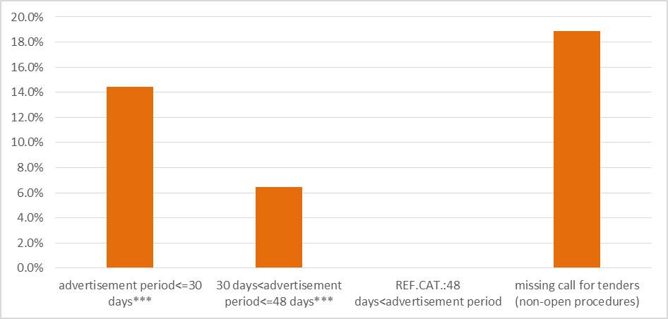
Modelling corrupt contracting: single bidding
Distribution of contracts according to the advertisement period
Tight deadline
Probability of single bid submitted for contracts compared with the market norm of 48+ days
Single bidding
Source: EU’s Tenders Electronic Daily (TED), Portugal , 2009-2014
Notes:
Single bidding on competitive markets matches the the corruption definition directly
Binary logistic regression controlling for contract value, main product market, contracting body type, location, etc.

Slide 13
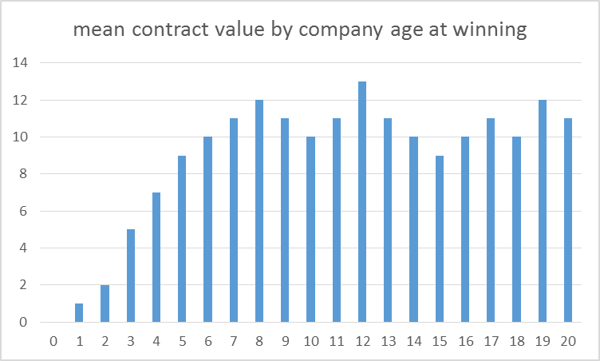
SRI: Expected success of companies by age
Gradual build-up of contracts
Natural fluctuation over time

Slide 14
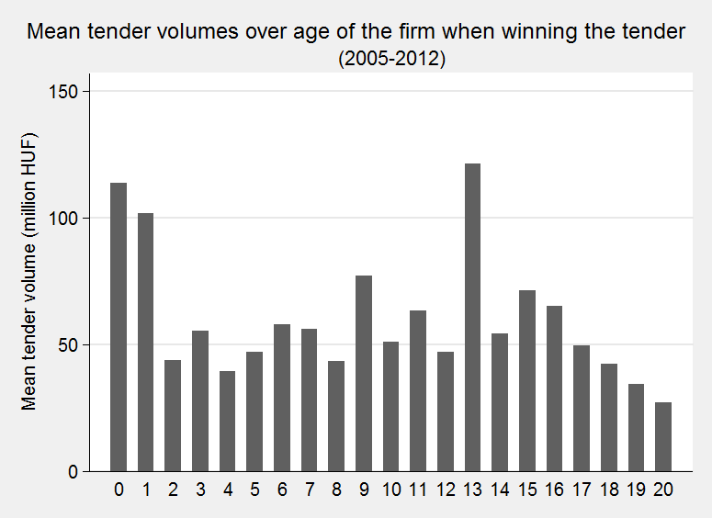
SRI: Observed success of companies at ‚specific’ ages
‚Just’ founded companies
Companies founded under party last in power
Hungary, 2010
Source: Fazekas, M., Lukács, P. A., & Tóth, I. J. (2015). The Political Economy of Grand Corruption in Public Procurement in the Construction Sector of Hungary. In A. Mungiu-Pippidi (Ed.), Government Favouritism in Europe. The Anticorruption Report 3 (pp. 53–68). Berlin: Barbara Budrich Publishers.

Slide 15
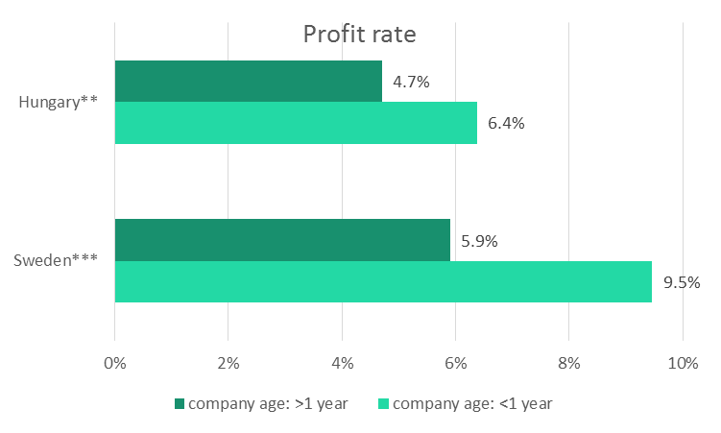
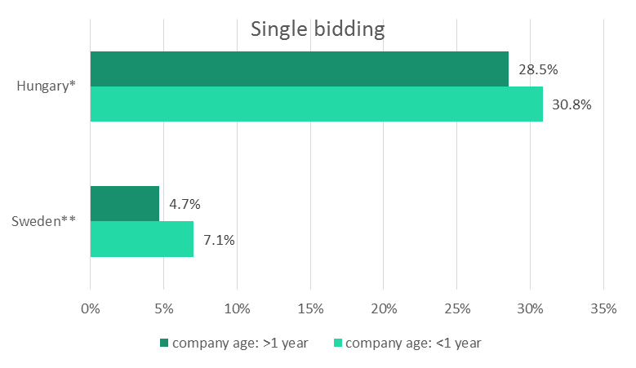
Clusters of risk: young firms
Source: Fazekas, Mihály , & Tóth, Bence, (2017), Proxy indicators for the corrupt misuse of corporations. U4 Brief. October 2017:6. U4 - Chr. Michelsen Institute, Bergen, Norway.

Slide 16
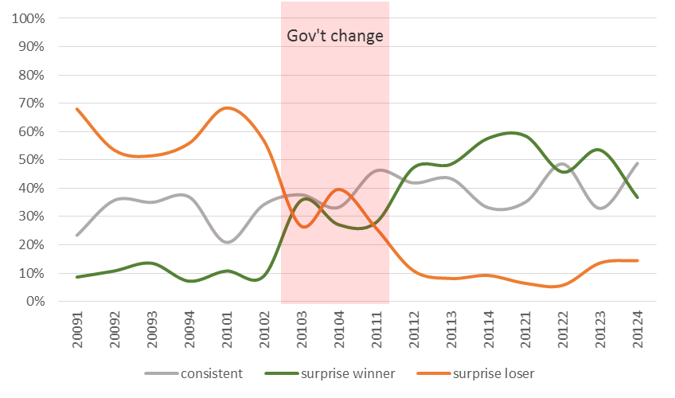
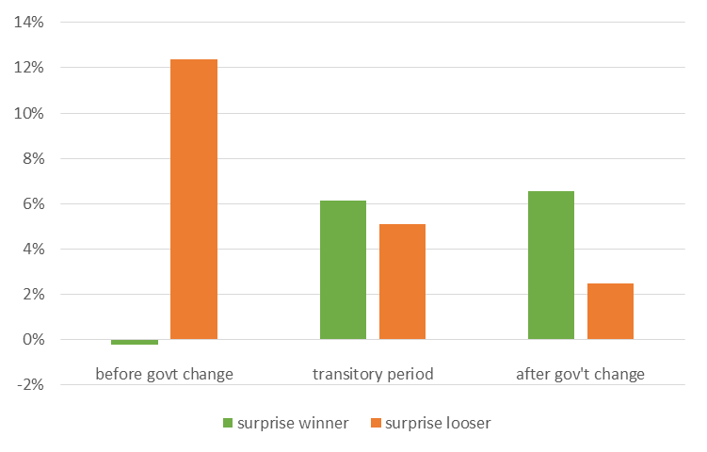
SRI: Politically driven company success: Hungary a paradigmatic case
Companies lose/win surprisingly when government changes
Hungary, 2009-2012
Surprise success goes together with procurement red flags (CRI)
Source: Dávid-Barrett, Elizabeth and Fazekas, Mihály, (2016). Corrupt Contracting: Partisan Favouritism in Public Procurement. GTI-WP/2016:02, Budapest: Government Transparency Institute.

Slide 17
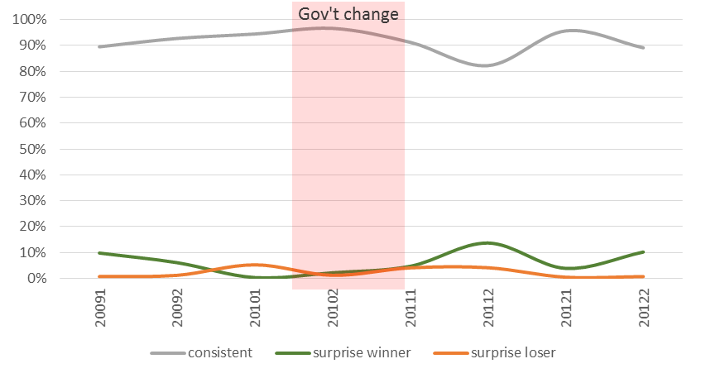
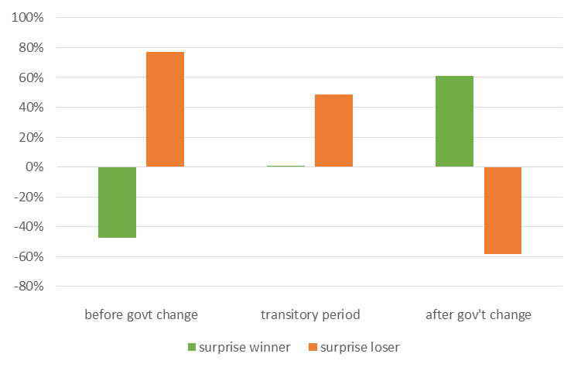
SRI: Politically driven company success: UK exception to the rule
Few companies lose/win surprisingly when government changes
UK, 2009-2012
Surprise success sometimes goes together with procurement red flags (CRI)
Source: Dávid-Barrett, Elizabeth and Fazekas, Mihály, (2016). Corrupt Contracting: Partisan Favouritism in Public Procurement. GTI-WP/2016:02, Budapest: Government Transparency Institute.

Slide 18
Minimum data scope for a corruption& collusion risk assessment
See: https://opentender.eu/blog/2017-03-towards-more-transparency/
Variable group | Variable
Buyer | Buyer’s name
 | Buyer’s unique ID
 | Buyer’s address
Bidder / bids | Bidder’s name
 | Bidder’s unique ID/tax ID
 | Bidder’s address
 | Number of bids submitted
 | Number of bids excluded
 | Bid price (details on total and unit prices)
 | Exact time of bid submission
 | Bid type (winner/loser bid)
 | Beneficial owners
Tender / contract | Procedure type
 | Framework agreement (1st/2nd stage)
 | Estimated price (details on total or unit prices)
 | Procurement type (service, supply, work)
 | CPV codes (by product type weight)
 | NUTS code(s) of contract implementation
 | Status (cancelled, pending, etc.)
Dates | Call for tender publication date
 | Bid submission deadline
 | Contract start and end dates
 | Publication date of contract award
 | Date of contract completion
Subcontracting | Subcontractor’s name and unique ID (tax ID)
 | Subcontractor’s share
Consortium | Consortium members’ name and unique ID (tax ID)
 | Consortium members’ share
Contract performance | Contract performance end date
 | Was performance according to the contract
 | Explanation in case of deferring from contract
 | Information on contract modification
 | Information on performance quality

Slide 19
Open data available: DIGIWHIST, BA/DFID & beyond
Unprecedented open data available!
Full European data&indicators on DIGIWHIST watchdog portals: https://opentender.eu
17.5 million contracts, 32 countries+EC
Development aid funded procurement+selected developing countries: World Bank, IDB, Europeaid + Tanzanian national data (www.govtransparency.eu/index.php/category/databases
Approach scaleable and standardized: ongoing work in
  Selected developing countries’ national data: Brazil, Chile, Columbia, India, Indonesia, Jamaica, Mexico, Paraguay, South Africa , Uganda
  Selected developed countries: US(federal contracting)
If you are interested, get in touch, happy to share data and collaborate!

Slide 20
II. Risk management tools

Slide 21
Using data for corruption prevention
Risk assessment:
  Mezo-level (e.g. sectoral, regional)
  Counterpart-level
  Project/tender-level
Policy advice: e.g. identifying vulnerabilities&trends
Automatic compliance checks: e.g. applying procurement rules
Notes:
Risk-based audit is essential as badly targeted audits have severe adverse consequences on the non-corrupt: less spending (Brazi), more discretionary spending (Chile)

Slide 22
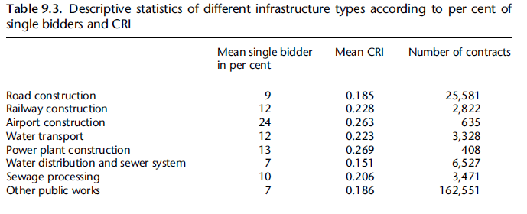
Sectoral risk scoring: infrastructure subsectors
Source: Fazekas, M. & Tóth, B. (2017), Infrastructure for whom? Corruption risks in infrastructure provision across Europe. In Hammerschmid, G, Kostka, G. & Wegrich, K. (Eds.), The Governance Report 2016. Oxford University Press, ch 11.

Slide 23
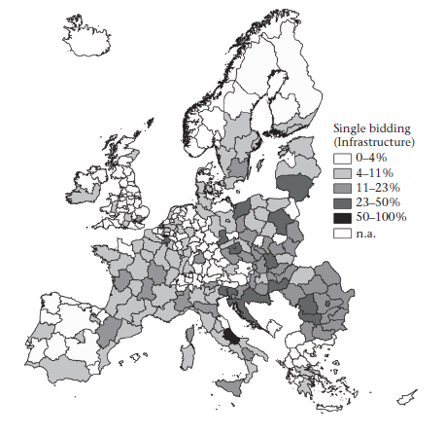
Corruption risks in infrastructure spending by region
Some regions in otherwise low corruption risk countries carry high risks
Source: Fazekas, M. & Tóth, B. (2017), Infrastructure for whom? Corruption risks in infrastructure provision across Europe. In Hammerschmid, G, Kostka, G. & Wegrich, K. (Eds.), The Governance Report 2016. Oxford University Press, ch 11.

Slide 24
Organisational risk scoring: EIB example
EIB counterpart avg. organisational risk scores
General PP behavior ~ Eib funded procurement behavior
250,000+ tenders, 10 tailored red flags

Slide 25
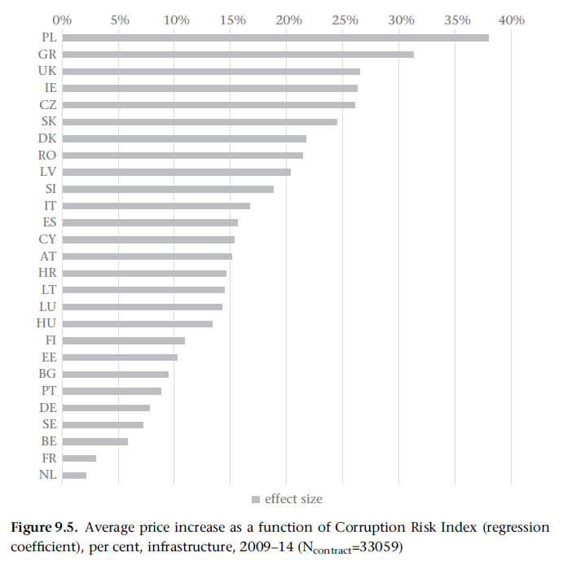
Corruption & overpriced projects
Source: Fazekas, M. & Tóth, B. (2017), Infrastructure for whom? Corruption risks in infrastructure provision across Europe. In Hammerschmid, G, Kostka, G. & Wegrich, K. (Eds.), The Governance Report 2016. Oxford University Press, ch 11.

Slide 26
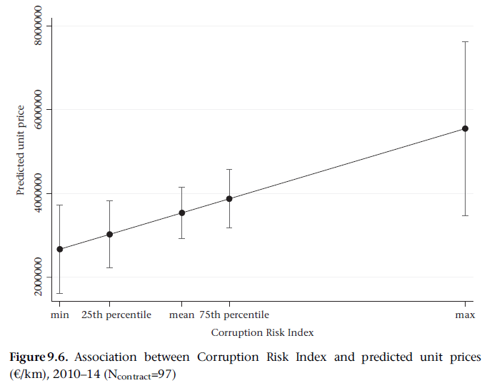
Corruption and road prices
Source: Fazekas, M. & Tóth, B. (2017), Infrastructure for whom? Corruption risks in infrastructure provision across Europe. In Hammerschmid, G, Kostka, G. & Wegrich, K. (Eds.), The Governance Report 2016. Oxford University Press, ch 11.

Slide 27
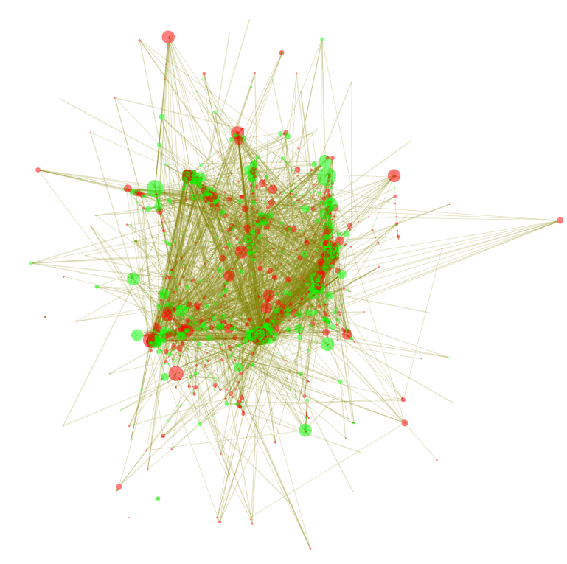
Complex risk scoring: Corruption risks cluster in contracting networks
Considerable clustering of risks
buyer-supplier bimodal network
N org. contract >=5 or <=50

Slide 28
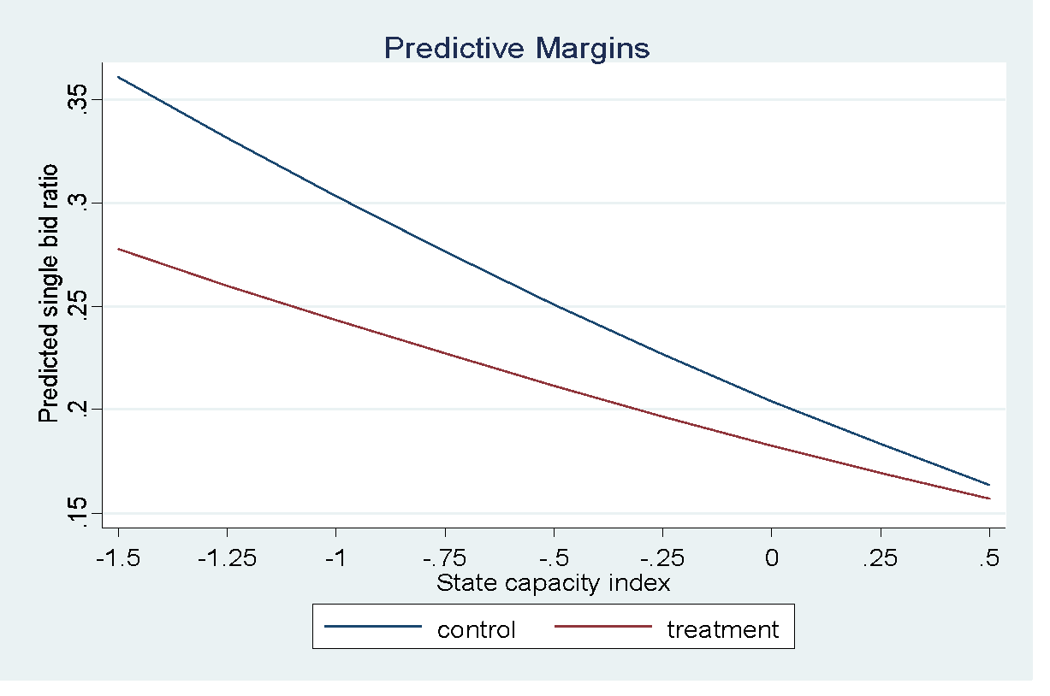
Policy evaluation:
Evaluating World Bank: 2003 GWS procurement rule change
Interaction of
regulatory change &
recipient state capacity
→ to predict bidder number
Source: Dávid-Barrett, E., Fazekas, M., Hellmann, O., Márk, L. & McCorley C. (2017) Controlling Corruption in Development Aid: New Evidence from Contract-Level Data. World Development, under review.

Slide 29
Quality of governance change over time
Source: Fazekas, Mihály, (2017): Assessing the Quality of Government at the Regional Level Using Public Procurement Data. WP 12/2017, Brussels: European Commission, Directorate-General for Regional Policy.

Slide 30
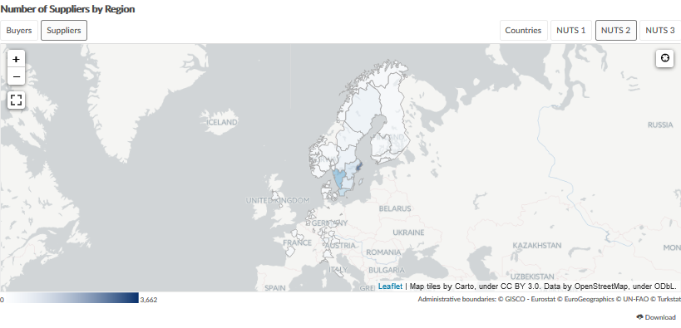
Tracking change over time:
Changing composition of foreign suppliers?
Home region of suppliers to Swedish buyers
Source: DIGIWHIST @ opentender.eu/se

Slide 31
Automatic compliance checks:
Misplaced tenders: avoiding TED
Number of contracts around the EU publication threshold – Services, central government, Poland
Source: Tóth, B., Fazekas, M. (2017): Compliance and strategic contract manipulation around single market regulatory thresholds – the case of Poland. GTI-WP/2017:01, Budapest: Government Transparency Institute. See: http://www.govtransparency.eu/index.php/2017/08/28/compliance-and-strategic-contract-manipulation-around-single-market-regulatory-thresholds-the-case-of-poland/
Notes:
More complicated analysis is also possible, for example repeated award by the same buyer in the smae CPV in a short time

Slide 32
Potential contract slicing
Number of tenders around the EU publication threshold in 2010-2011 (left) and 2012-2013 (right) – Services, local government, Poland
Source: Tóth, B., Fazekas, M. (2017): Compliance and strategic contract manipulation around single market regulatory thresholds – the case of Poland. GTI-WP/2017:01, Budapest: Government Transparency Institute. See: http://www.govtransparency.eu/index.php/2017/08/28/compliance-and-strategic-contract-manipulation-around-single-market-regulatory-thresholds-the-case-of-poland/

Slide 33
Does gaming matter?
Ratio of single bidder contracts around the EU threshold (2010-2015) – local authorities, services, Poland
Source: Tóth, B., Fazekas, M. (2017): Compliance and strategic contract manipulation around single market regulatory thresholds – the case of Poland. GTI-WP/2017:01, Budapest: Government Transparency Institute. See: http://www.govtransparency.eu/index.php/2017/08/28/compliance-and-strategic-contract-manipulation-around-single-market-regulatory-thresholds-the-case-of-poland/

Slide 34
3 options for tapping into Big Data analytics
Use existing national systems: many countries have sufficient national data (LINKING!)
  Can get started tomorrow☺
Invest into national systems: e.g. WB’s work in Bangladesh
  Mid-term solution: 2-3 years until data is ready
Build a central PP system
  WB is doing that and it is hard

Slide 35
LAC national public procurement landscape
Publicly available, sufficeint quality datasets already collected (or close to it):
  Brazil (federal)
  Chile
  Columbia
  Jamaica
  Mexico
  Paraguay
Good enough quality national PP data for risk assessment (as I know)
  Brazil (selected states)
  Costa Rica
  Ecuador
  Peru
  Uruguay

Slide 36
What is possible on the short term: e.g. Paraguay public data
Explorative analysis using public data: understanding the local context
Comparing spending concentration of procuring entities which received/managed or not IDB funds (10+ contracts awarded per year)

Slide 37
III. Reducing rather than displacing corruption in development aid

Slide 38
Motivation
The ‚typical’ anticorruption intervention is small-scale prone to evasion and strategic response
Rise of focused anti-corruption impact evaluations and feeding scientific findings into policy
Measuring unintended consequences and displacement effects entered center stage recently
High-level, organised corruption is particularly prone to strategic adaptation

Slide 39
Main research question
Do donor reforms aiming to open up competition lower corruptions risks or merely displace them?

Slide 40
Hypotheses
H1: Increased donor oversight and wider access to aid-funded public procurement decrease corruption risks associated with lack of competition.
H2: Increased donor oversight and wider access to aid-funded public procurement displace corruption risks to less competitive procedure types and higher risk contract signature.
H3: Increased donor oversight and wider access to aid-funded public procurement increase corruption risks in already risky non-competitive procedure types.
H4: Increased donor oversight and wider access to aid-funded public procurement expand participation of less connected (foreign) bidders at the expense of more connected (domestic) bidders.

Slide 41
Data, intervention and causal identification
Data: Project finance to governments (no budget support, no grants to NGOs/private sector), World Bank prior reviewed tenders, goods & works, 2000-2008, contracts above 25K USD
Intervention: World Bank changes in public procurement rules for Goods and Works in November 2003
Same rules, different contexts
Most significant changes:
  Donor oversight: e.g. intro of procurement plans, extension of audits to bidders (not just winners)
  Tender advertisement: wider use of electronic advertisement
  E-procurement
Project-level rule implementation → tight contract level matching
Number of contracts awarded in the treated and control groups
 | 2000 | 2001 | 2002 | 2003 | 2004 | 2005 | 2006 | 2007 | 2008 | Total
Control | 1,307 | 2,434 | 3,572 | 4,062 | 4,060 | 3,432 | 2,160 | 1,505 | 690 | 23,222
Treated | 0 | 0 | 0 | 0 | 319 | 1,133 | 1,496 | 1,601 | 1,047 | 5,596
Total | 1,307 | 2,434 | 3,572 | 4,062 | 4,379 | 4,565 | 3,656 | 3,106 | 1,737 | 28,818

Slide 42
Indicators
Tendering phase | Indicator name | Indicator definition
Bidding | Non-competitive procedure type | 1=non-open procedure types (e.g. single source) 0=open procedure types (e.g. international competitive bidding)
Contract award | Single bid | 1=1 bidder per contract 0=2 or more bidders per contract
 | Bidder number (trimmed)* | Bidder number (50+ bidders set at 50)
 | Repeat winner | 1=supplier won at least 2 contracts in 1998-2014 0=supplier won only 1 contract in 1998-2014
 | Foreign supplier* | 1=supplier is registered in a foreign country 0=supplier is registered in the country of buyer
Contract signature | Risky signature period | 1=Time between award date and contract signature date is shorter than 14 days 0=Time between award date and contract signature date is longer than 14 days
Different phases of the procurement process allow for different ways of stealing from aid contracts

Slide 43
Results: full sample

Slide 44
Results: competitive procedures

Slide 45
Results: non-competitive procedures

Slide 46
Conclusions
Sizeable strategic responses mitigating overall positive effects
H1: Single bidding: 22%->19%
H1: Repeat winner: 72%->65%
H2: Closed procedures: 7%->10%
H2: Risky signature period: 25%->29%
H3: Competitive procedures: more competition; non-competitive procedures: less competition (single bidder % gap 49%->71%)
H4: Foreign winner: 16%->14%
→ Net welfare effect: Zero? Negative?

Slide 47
Further readings: digiwhist.eu/resources
Fazekas, M., & Kocsis, G. (2017). Uncovering High-Level Corruption: Cross-National Corruption Proxies Using Government Contracting Data. British Journal of Political Science, available online.
Fazekas, Mihály, (2017): Assessing the Quality of Government at the Regional Level Using Public Procurement Data. WP 12/2017, Brussels: European Commission, Directorate-General for Regional Policy.
Dávid-Barrett, Elizabeth, Fazekas, Mihály, Hellmann, Olli, Márk, Lili, & McCorley, Ciara, (2017): Controlling Corruption in Development Aid: New Evidence from Contract-Level Data. SCSC Working Paper No. 1. Sussex Centre for the Study of Corruption, University of Sussex.
Tóth, B., Fazekas, M. (2017): Compliance and strategic contract manipulation around single market regulatory thresholds – the case of Poland. GTI-WP/2017:01, Budapest: Government Transparency Institute.
Fazekas, Mihály , & Tóth, Bence, (2017), Proxy indicators for the corrupt misuse of corporations. U4 Brief. October 2017:6. U4 - Chr. Michelsen Institute, Bergen, Norway
Fazekas, M. & Tóth, B. (2017), Infrastructure for whom? Corruption risks in infrastructure provision across Europe. In Hammerschmid, G, Kostka, G. & Wegrich, K. (Eds.), The Governance Report 2016. Oxford University Press, ch 11.
Fazekas, M., Cingolani, L., & Tóth, B. (2016). A comprehensive review of objective corruption proxies in public procurement: risky actors, transactions, and vehicles of rent extraction: GTI-WP/2016:03. Government Transparency Institute. Budapest.
Fazekas, M. and Tóth, I. J. (2016). From corruption to state capture: A new analytical framework with empirical applications from Hungary. Political Research Quarterly, 69(2).
Dávid-Barrett, Elizabeth and Fazekas, Mihály, (2016). Corrupt Contracting: Partisan Favouritism in Public Procurement. GTI-WP/2016:02, Budapest: Government Transparency Institute.

